Slide 1

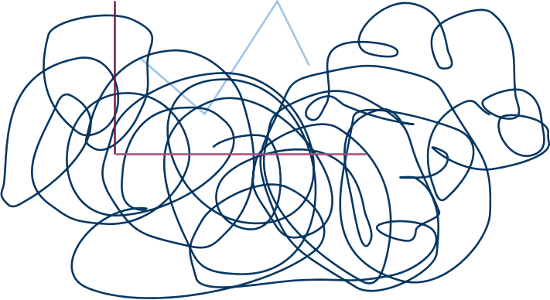
Improving out of vocabulary name resolution
The Hanks
David Palmer and Mari Ostendorf
Computer Speech and Language 19 (2005)
Presented by Aasish Pappu, Oct 26, 2009

Slide 2
Introduction
  OOVs ~ Names
  Mountainous vocabulary ??
  John, Jean, Joana .... ?? okay, a multiple personality disorder !
  Each OOV token contributes on average 1.5 errors (Hetherington '95
  Major source of word errors in ASR hypothesis. why ?
    [from TDT broadcast corpus news]
    9.4% of the words are part of name phrases
    45.1% of the utterances contain at least one name phrase.
    WER: 38.6% for words within name phrases
    WER: 29.4% for non-name words
    OOV rate is less than 1% for large-vocab (48-64k) systems, but significantly higher for words in name phrases.
    [ ]

Slide 3
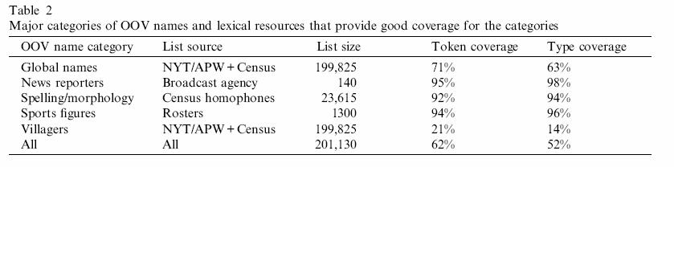
Primary sources of OOV person names
  "New" names of global importance
    News worthy: World leader, terrorists, criminals and corporate leaders
    Assuming entities of global importance appear both in broadcast and print during same period
  News Reporters
    "CNN's John Zarrella has the story..."
    readily available from news agency itself
  Spelling and Morphological variants
  Sports Figures
  Villagers and human interest personalities (Joe the plumber is an outlier ?)

Slide 4
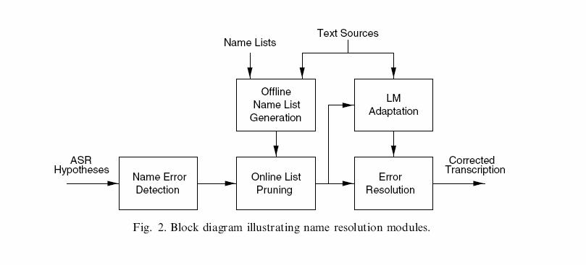
Approach
D.D. Palmer, M.Ostendorf /Computer Speech and Language 19 (2005) 107-128

Slide 5
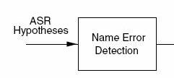
Name Error Detection
  Named Entity Recognition: A HMM like model with state dependent bigrams to detect NEs. (Palmer and Ostendorf 2001a)
  Finding OOV names by detecting word errors in the hyp.
    Acoustic cues, ASR error patterns
    More information sources like surrounding language context.
  Integration of word confs. into probabilistic model jointly identify names and errors.
  Simple lattice from hypothesis with error arcs in parallel.
  Iterative refinement of Word confidence estimates. (Gillick et al. '97; Palmer and Ostendorf 2001b)
  Viterbi decoding to find the best path through lattice.

Slide 6


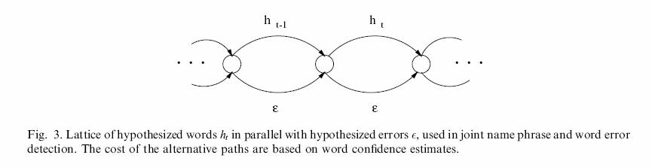
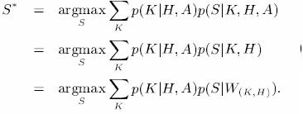
Name Error Detection
  Errors are explicitly modeled using parallel arcs
  a sequence of error indicator variables k=1, h is error otherwise k=0
  A : confidence score and other confs.
  Find the maximum posterior prob state sequence
assuming specific value of h at an error does not provide additional information

Slide 7




Name Error Detection
  Part1: the error model, P(K|H, A), errors are assumed to be conditionally independent given the hypothesis H and evidence A.
  Part2: but there is no efficient decoding algorithm, hence
where,
  Goal: to find words that are in error (for subsequent correction) as well as the NEs

Slide 8
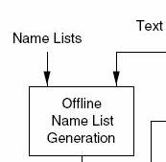
Offline Name List Generation
  Identify good lexical resources
  Rank words based on frequency statistics (from the txt srcs)
    Alternatively, filter the text sources based on document relevance (Iyer and Ostendorf '97)
  Final list contains both IV and OOV items (to allow the option of not changing the recognizer's output)
  Do G2P: produce phoneme based pronounciation strings for each word (for use in online scoring).

Slide 9
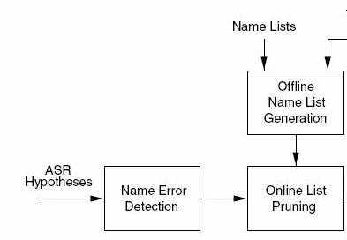
Online list pruning
  Input: candidate name error, phone sequence for that word.
  Compare pronounciations: for each of the words in the extended word list
    Compute distance: using a string matchine procedure and a set of phone (sub, ins, del) costs.
    Rank according to distance and optionally word frequency.
  Did you say Phonetic distance???

Slide 10
Phonetic Distance
  Akin to noisy channel approach (stochastic transduction model)
    Measure edit distance between two phoneme sequences
    According to trainable weighting system (edit weights based on all possible sequences)
  Phonetic feature based weighting function (Bates and Ostendorf 2001)
  Automatically derived weights from training data using EM. (Ristad and Yianilos '97).
    Weight estimation: Used a set of ASR output from a portion of TDT data separate from the experiments.
  Automatic_alignment(Reference, ASR words) and conversion toT2P (Lenzo '98).
  In essence, ASR output is treated as phonemic misspellings.
  Applications of Phonetic Distance:
    Name-list pruning, Error Correction and Name normalization

Slide 11
Error Resolution
  Obj: Error correction in the regions of high info. content.
  Impact: quality of IE of NE.
  Error token detection algo (automatic & oracle) name detection.
  Several candidates from the pruned set.
    phonetic or lm score or via additional pass.
  Rerunning: Larger gains, but impractical(say IR apps).
  Using, adapted language model based on temporally or topically relevant text containing target words to achieve high accuracy, like for resolving spelling alternatives (Lewinsky vs Lewinski)
  Valuable hindsight about the context in which the candidate OOVs appeared.

Slide 12
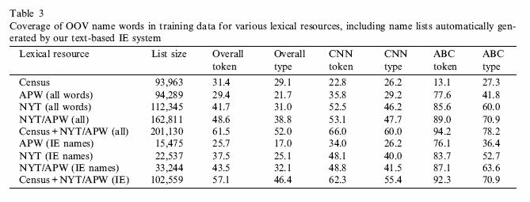
Numb3rs
DATA: TDT4 broadcast news.
Error detection: 65.7% recall, 59.0% precision, Fmeasure:62.2
(with iterative confidence estimation, Gillick et al. '97)
with simple confidence threshold : 66.1%R, 48.8%P and 56.1%F
For OOV correction : R is more important than P, since the correction step
involves leaving the hypothesized word unchanged.

Slide 13
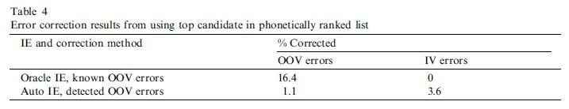
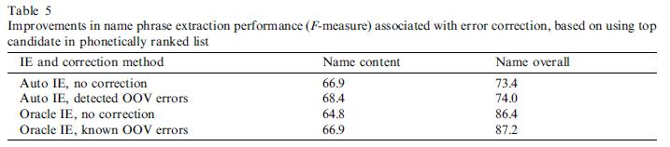
more 1,2,3,4,5... error correction using phonetic distance
DATA: NYT/APW, coverage: 43%, 40% of corrected names are covered.
Although, there is a direct impact on IE, there is minor improvement in overall WER of the data.

Slide 14
Recap
  Detect OOV errors.
  Generate targeted name lists for candidate OOV
  Offline generation of a large name list and online pruning based on a phonetic distance.
  The resulting list can be used in a rescoring pass in automatic speech recognition.
  Wide variety of sources, including automatic name phrase tagging of temporally relevant news text can be used for NE correction.

Slide 15
Conclusion
  Error detection combined with phonetically ranked list helps.
  Same name list generation could be useful for generating homophones list.
  Phoneme lattice could be a richer representation instead of word lattice.
  Correction of multi-word phrases would help as oppposed single word because of automated alignment issues.
  Dealing with plural and possesive forms could be addressed.

Slide 16
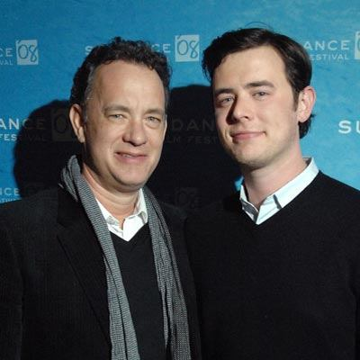
Thanks !
The Hanks

